Slide 1
Analysis of Home Credit Group’s Credit Default Risk
By: Nirav P. Sheth

Slide 2

Introduction
Client: Home Credit Group
Purpose: open mortgages services available to the unbanked population
Goal: Create predictive model to decide whether to provide the loan
Atleast less than national Average

Slide 3
Data SETs
Train Data set:
308K Client Applications with financial, behavioral, time-based, and descriptive information
Previous Credit Data:
Previous Application: information if Client had previous application
13.8M rows of data from Credit Bureau
50% of Client application available via Credit Bureau
Installment Payments: Credit History Information on payments on Loans
Helps to check any nonpayments for current clients

Slide 4
Data Cleaning
Aggregating
Historical Datasets needed to be aggregated due to 1 to many relationships
Used Pivot_table method with numpy.mean, sum, and count functions
Merging
Left Merged Application Train with aggregated datasets
Dummying Categorical Columns
Used pandas get_dummies to convert categorical columns into numerical
Feature selection
Used SelectFromModel with LassoCV as classifier to find top 15 columns

Slide 5

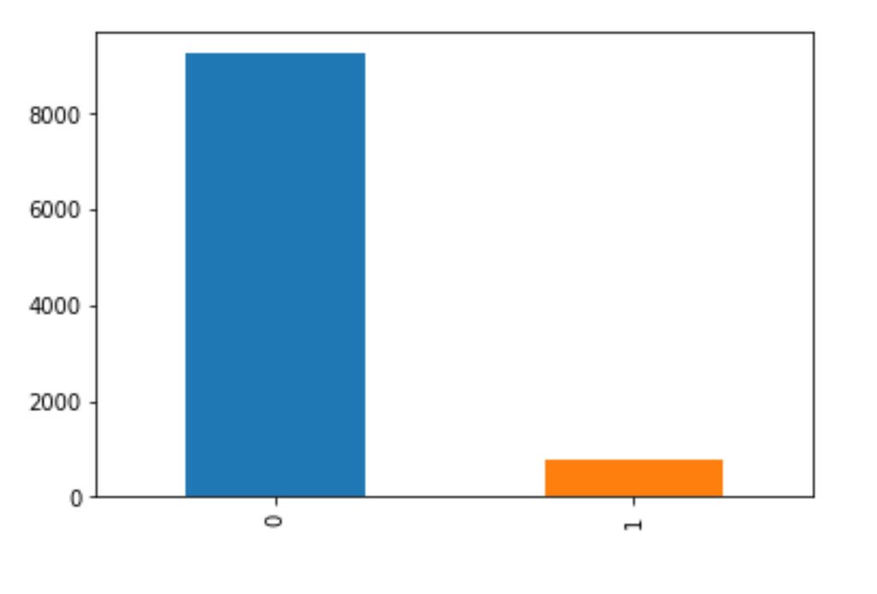
Client Application: Target Column
TARGET Column:
0: Payment on time (93% of the sample)
1: Delinquency >30+ days (7% of the sample)
US Average Delinquency rate: 4.4%
While it looks low, it is still quite large compared to National average
Target

Slide 6
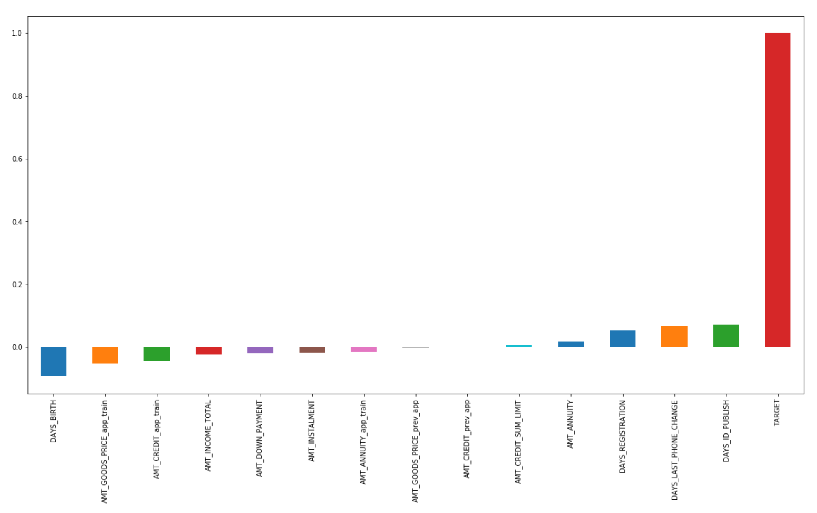
Correlation analysis vs Target
3 Columns of interest:
Days_BIRTH: Years Old
DAYS_LAST_PHONE_CHANGE: time since last phone change
DAYS_ID_PUBLISH: Time since id change

Slide 7
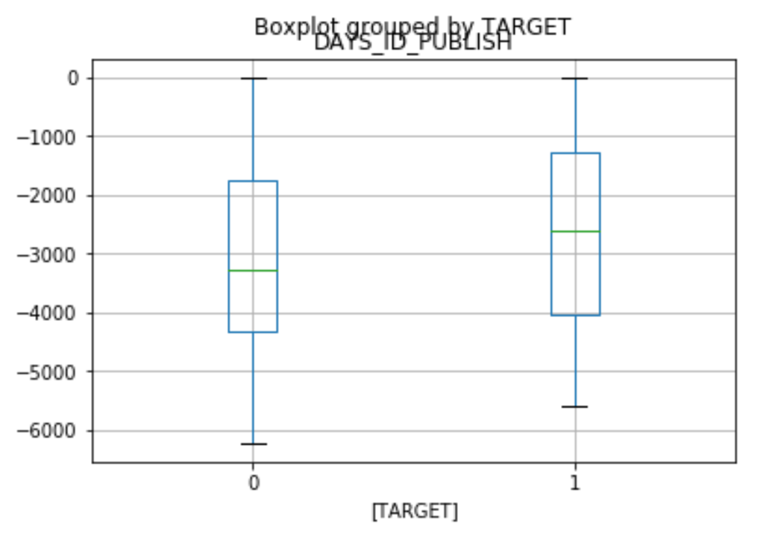
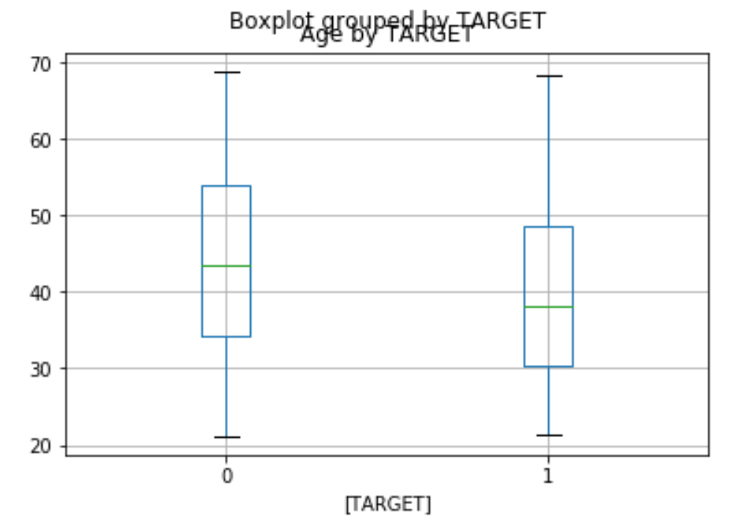
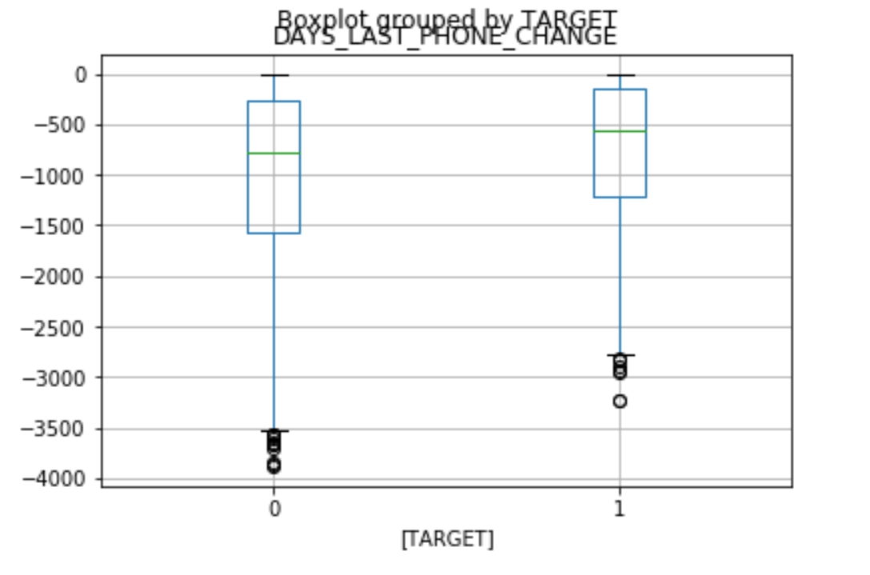
TARGET vs Features
Delinquency as Age
Delinquency as ID_PUBLISH
Delinquency as DAYS_LAST_PHONE_CHANGE

Slide 8
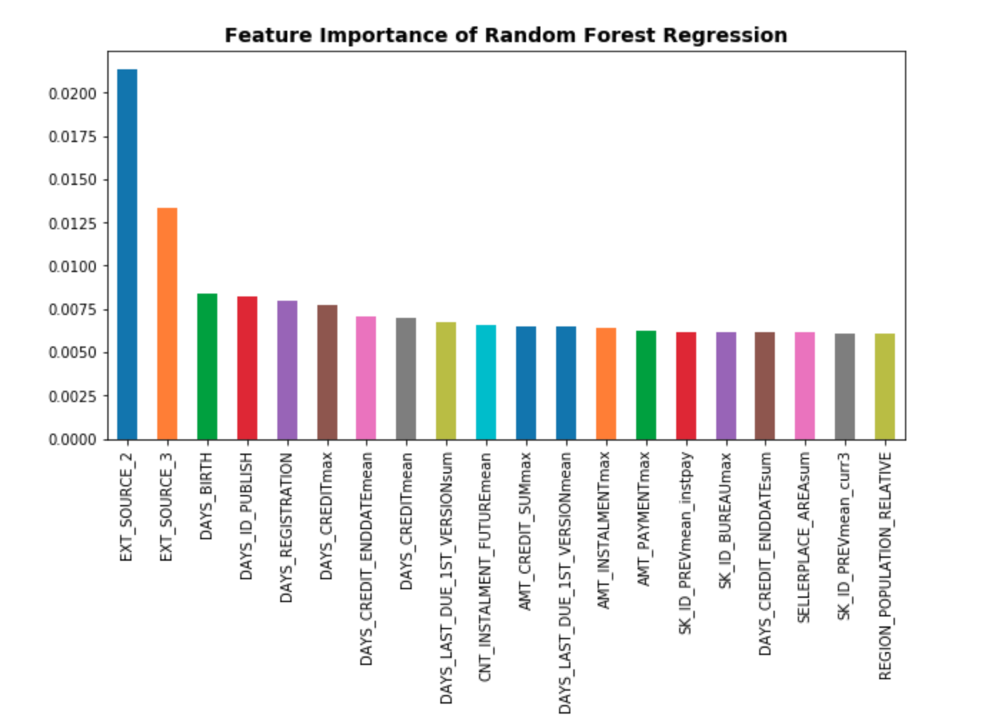
Random Forest Feature Importance
Top 20 Features explains about 16% of the variance
Important Features:
Ext_Source 2 & 3: Normalized score of external data
Days_Birth: Age of Applicant
Days_ID_Publish: Number of Days before the application did the applicant change their identity
Overfitted model which did not generalize well to the dataset
Random Forest AUC Score: .58
Random Forest F1 Score: .11

Slide 9
Future Work & Conclusion
Missing Values: Large amounts of missing values resulted due to the sparsity of the dataset.
Outliers: Work on eliminating outliers
Feature Elimination: Reduce features of data set to decrease overfitting
Machine Learning: Use additional ML classifiers like LightGBM
Conclusion: Difficult to understand credit information without historical financial information. Current model does not generalize well to model, however future work should improve overall predictive capabilities.

